Slide 1
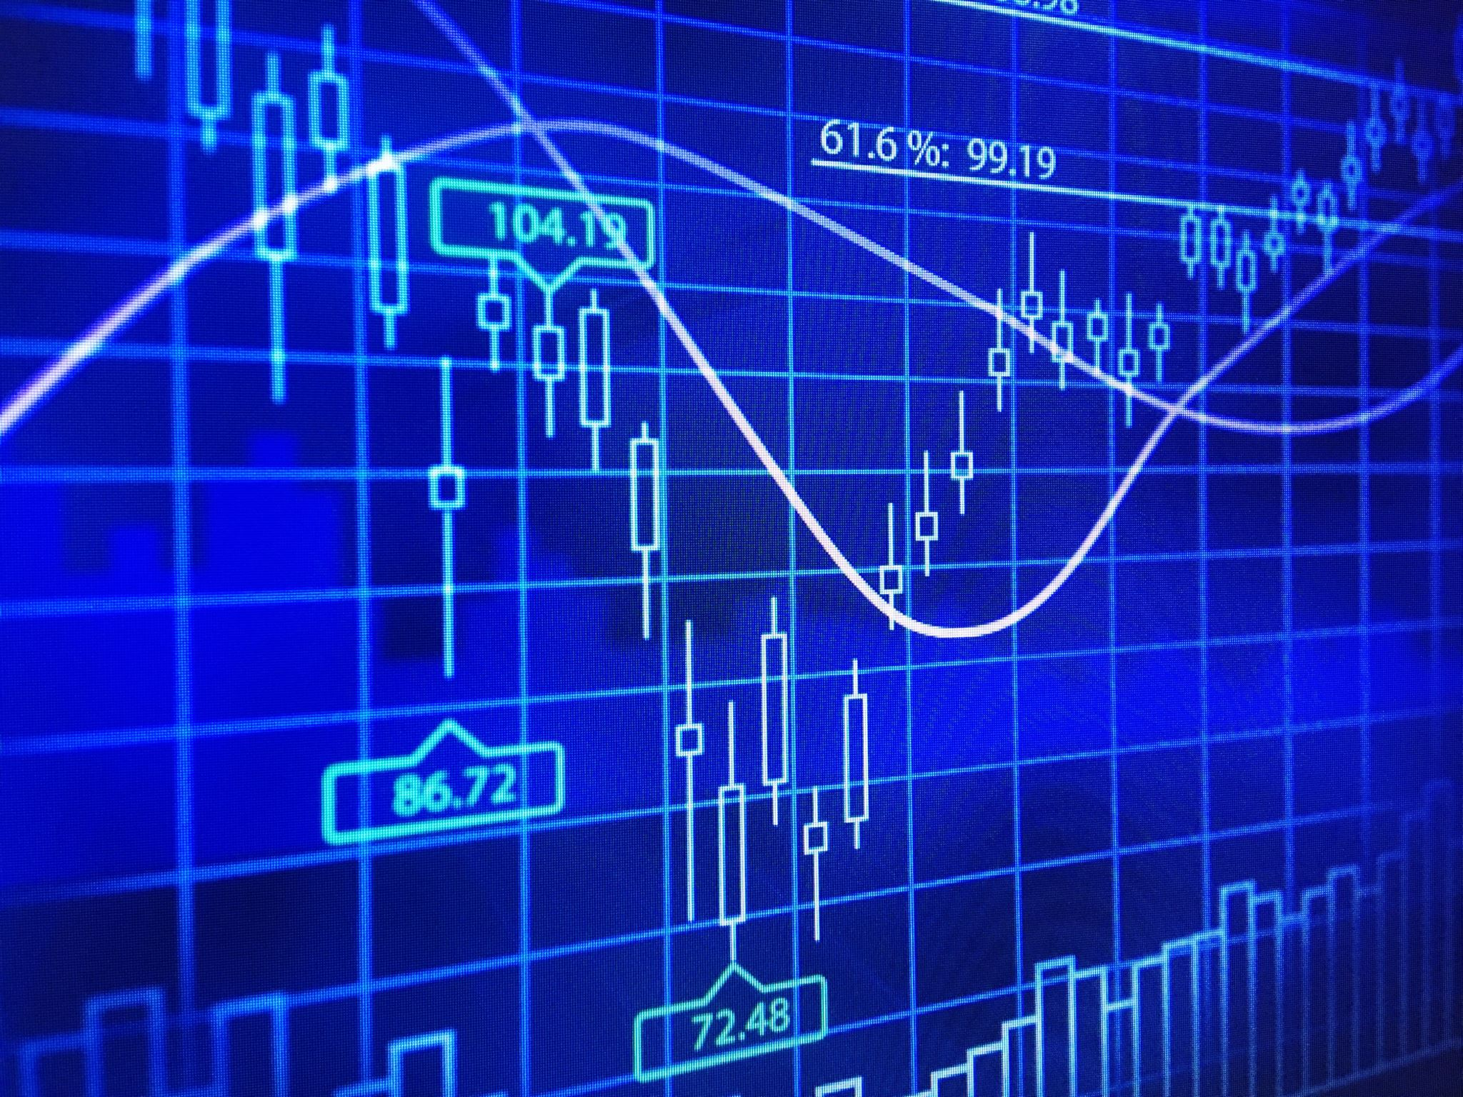
Relationship mining

Slide 2
Relationship mining
Correlation mining
Association Rule Mining
Sequence mining

Slide 3
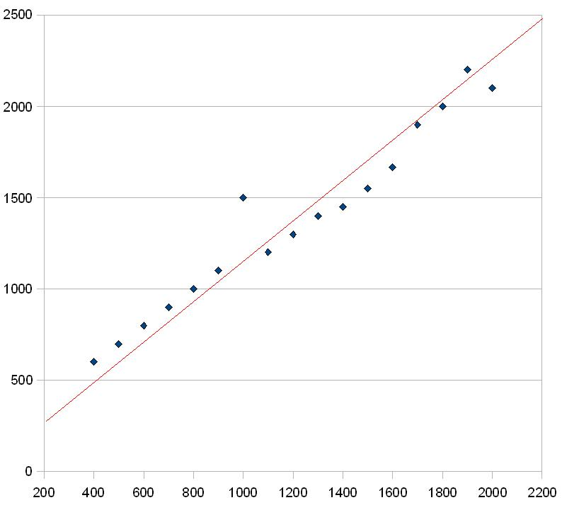


Correlation mining

Slide 4
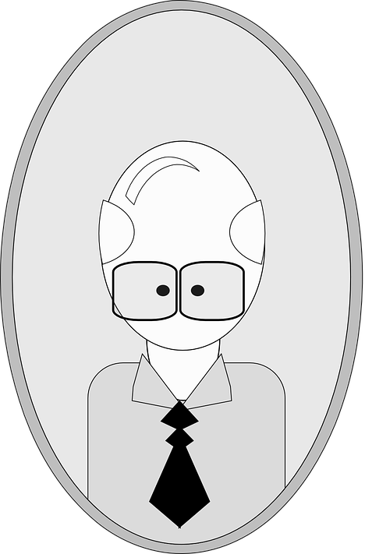
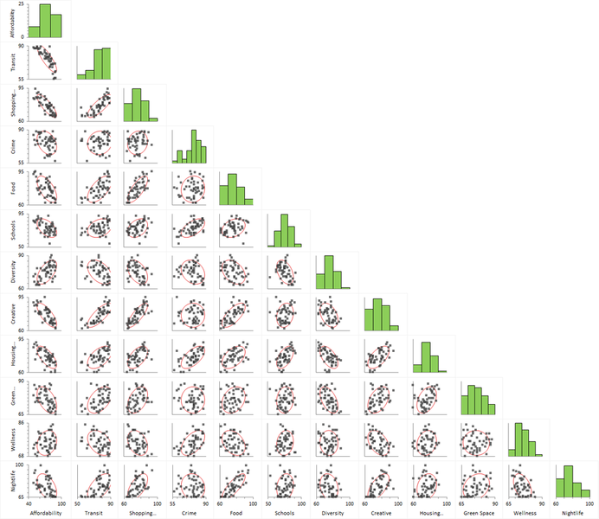
Crossing multiple variables

Slide 5


Correlation mining
Beware of P-hacking (data dredging)
Meaningless correlations

Slide 6


Association Rule Mining

Slide 7
Association Rule Mining

Slide 8
Market Basket Analysis

Slide 9
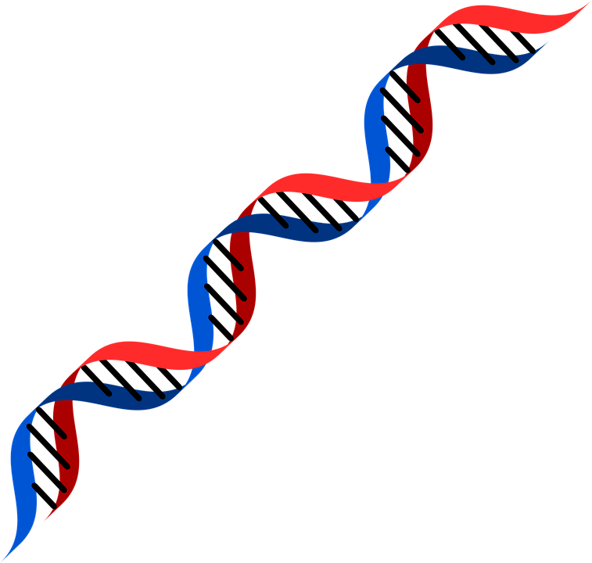

Sequence Mining
ATGA
GTAA

Slide 10
Data on real time electricity consumption

Slide 11
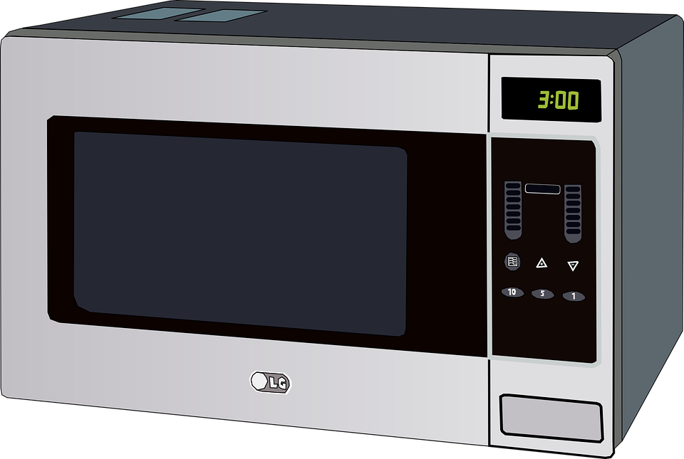

All devices in your house have a signature

Slide 12

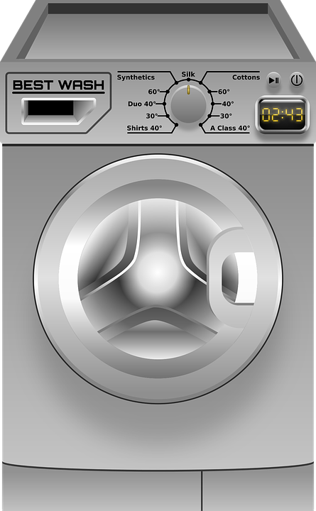

Sequences of device uses

Slide 13
Mining for recurring patterns
Then interpreting them …

Slide 14

Conclusion : Mining massive datasets

Slide 15
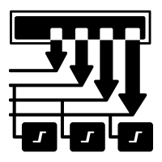
Databases so large that it is not possible run analyses on a single computer
Parallel and distributed processing
New programming paradigms

Slide 16
Learn programming environments
Map-reduce
Become familiar with popular Big data tools
Hadoop ecosystem, Google GFS, Apache Spark

Slide 17


